Slide 1


MIT Media Lab
Viral Communications
September 2019

Slide 2

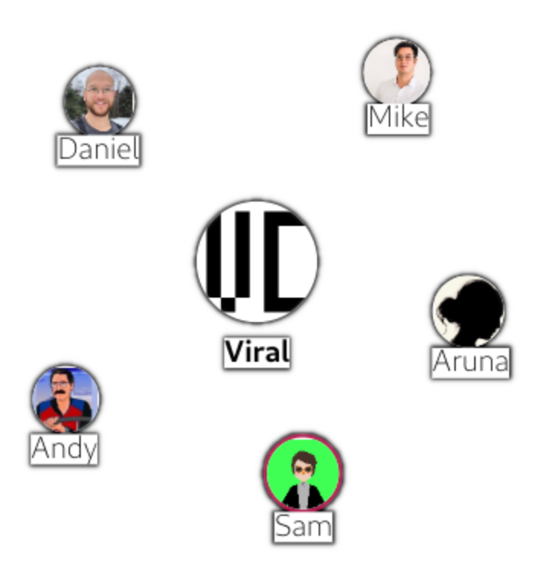

A locally owned and operated platform for community events and discussions
Easy moderation tools put local leaders in control
Flexible options for public and private communication
Extensible free software architecture
Viral Communications
September 2019
Andrew Lippman

Slide 3



Why build a new organizing tool?
Viral Communications
September 2019
Andrew Lippman

Slide 4

Community Infrastructure
Viral Communications
September 2019
Andrew Lippman

Slide 5
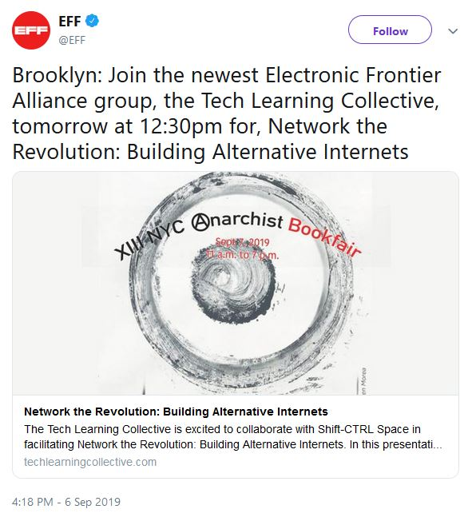


Tech Learning Collective
Viral Communications
September 2019
Andrew Lippman

Slide 6
A locally owned and operated platform for community events and discussions
Easy moderation tools put local leaders in control
Flexible options for public and private communication
Extensible free software architecture
Viral Communications
September 2019
Andrew Lippman

Slide 7




Features
Public homepage
Events
Working Group 1
Channels
Working Group 2
Discussions
Viral Communications
September 2019
Andrew Lippman

Slide 8
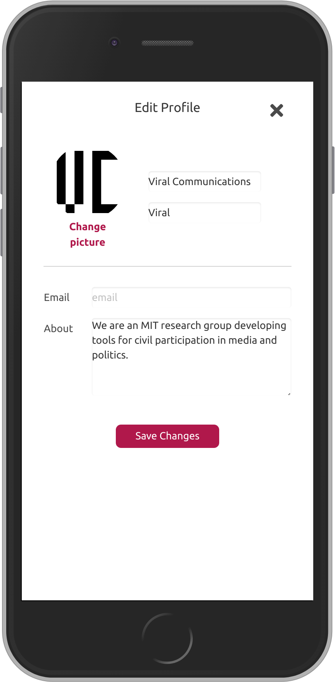
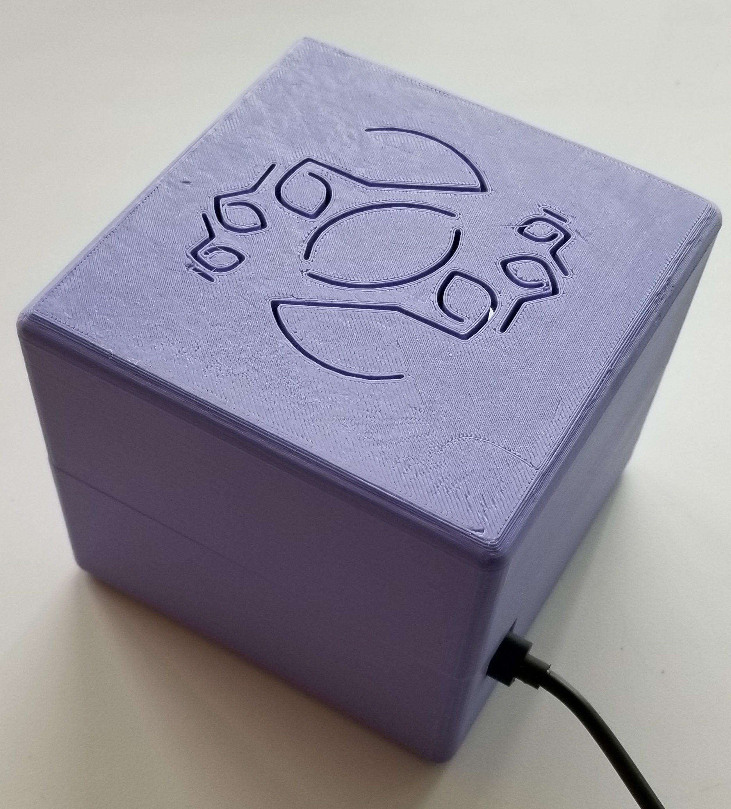

Any group can host their own CivicLink:
1. Install the box and register a public name, i.e. viral.civiclink.network
2. Design the group’s public face. A group website is automatically created!
3. Invite members to the group
Viral Communications
September 2019
Viral Communications
September 2019
Andrew Lippman
Andrew Lippman

Slide 9
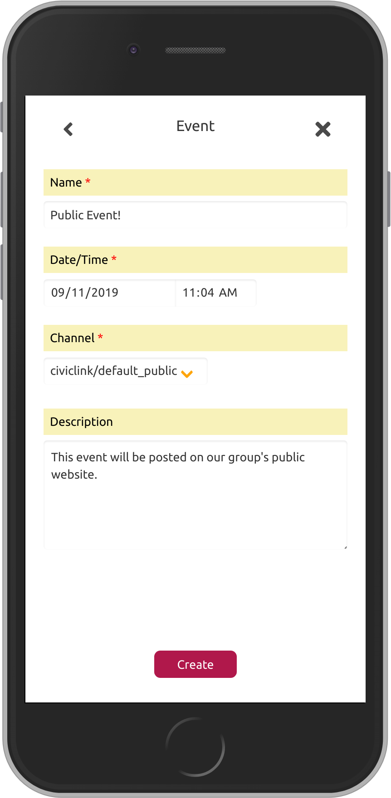
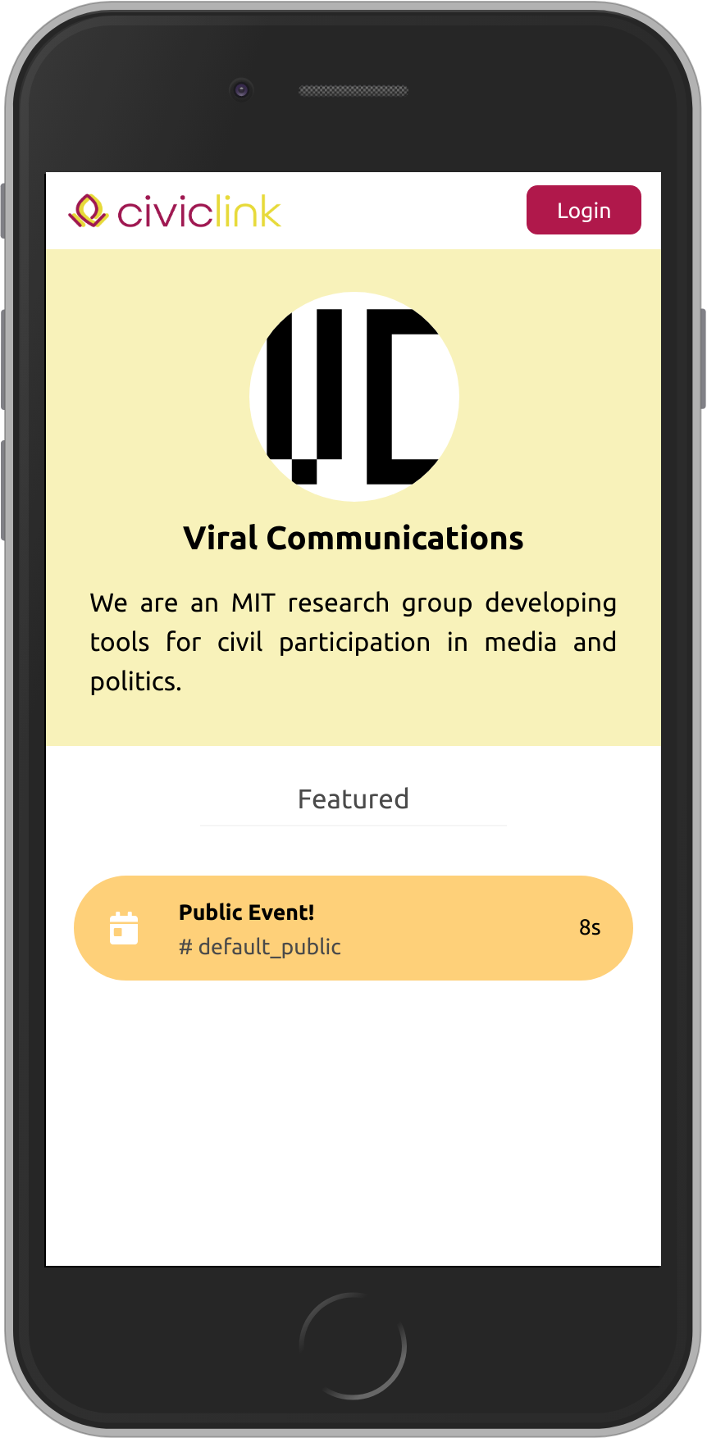
Update the public page by adding content to the “default public” channel
The contents of this channel are automatically posted publicly
Anyone can access this page by visiting viral.civiclink.network
Viral Communications
September 2019
Viral Communications
September 2019
Andrew Lippman
Andrew Lippman

Slide 10
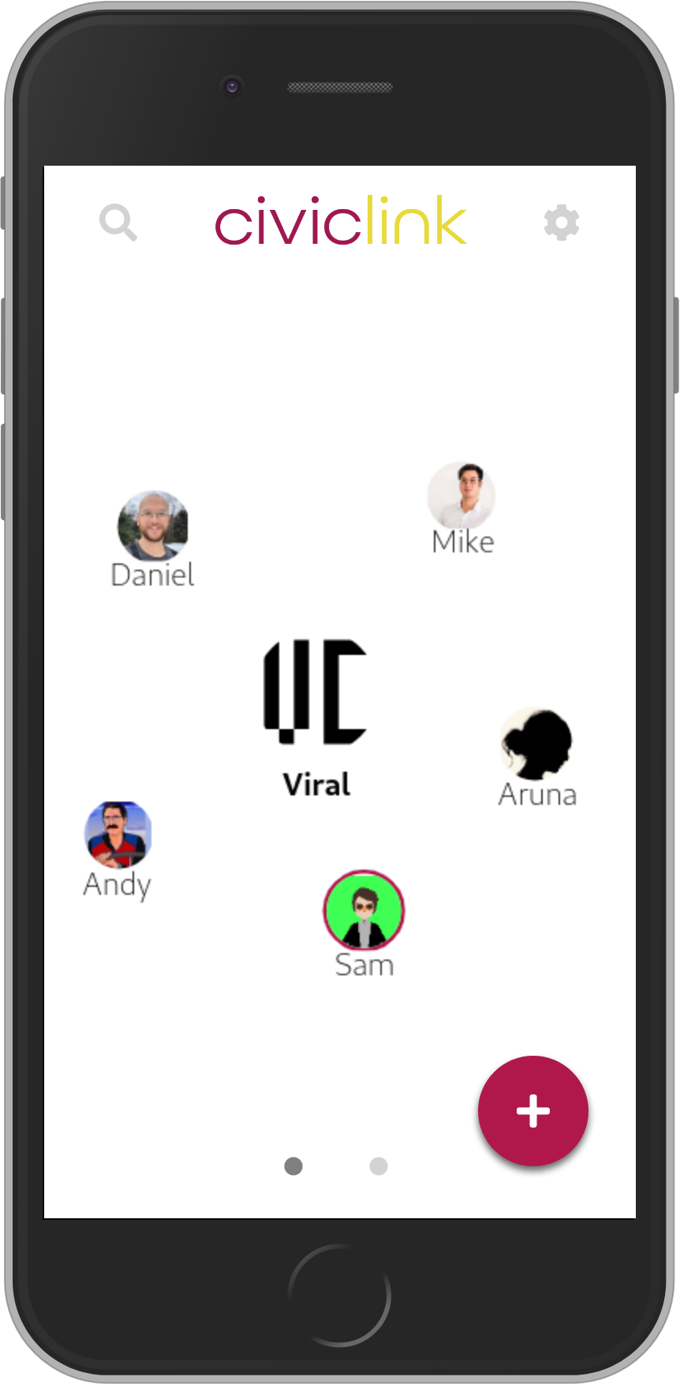
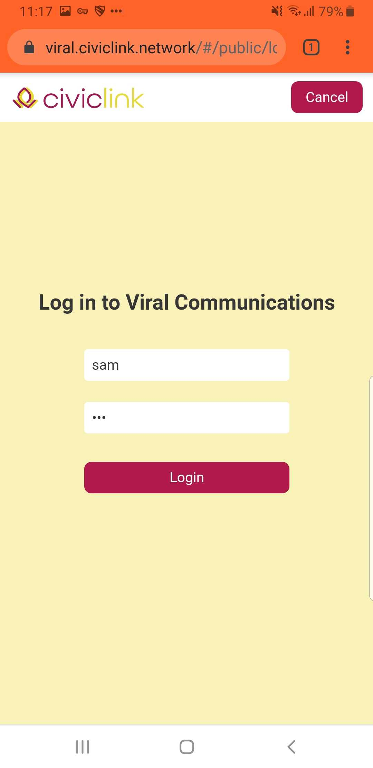
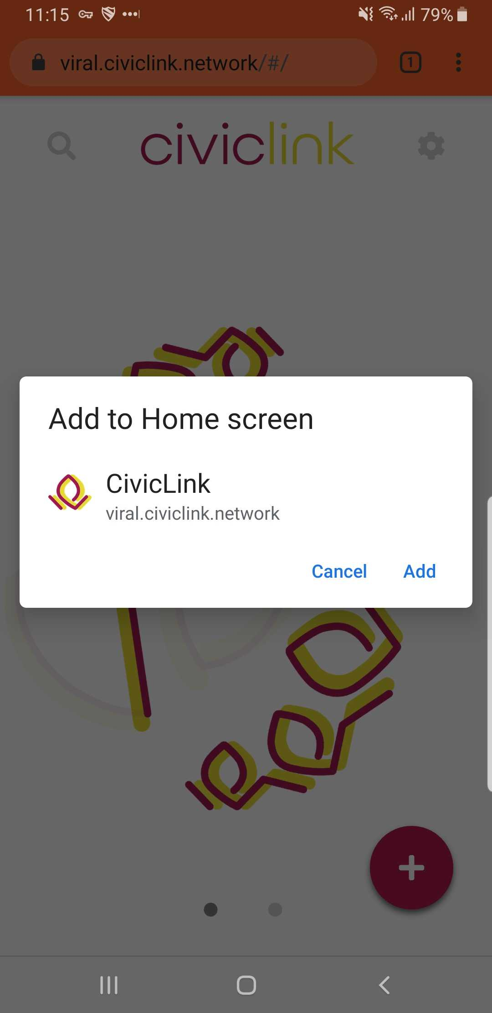
Members can log in to access the CivicLink web app
Viral Communications
September 2019
Viral Communications
September 2019
Andrew Lippman
Andrew Lippman

Slide 11
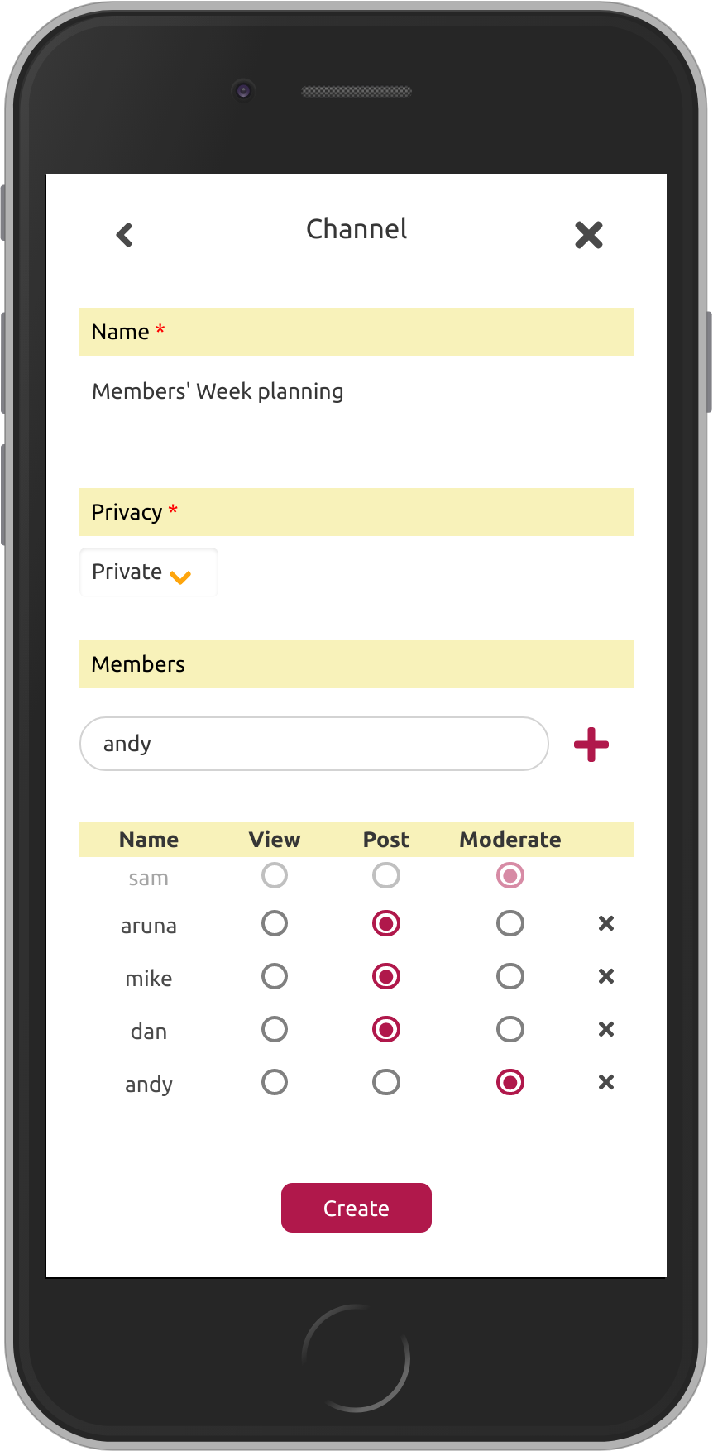
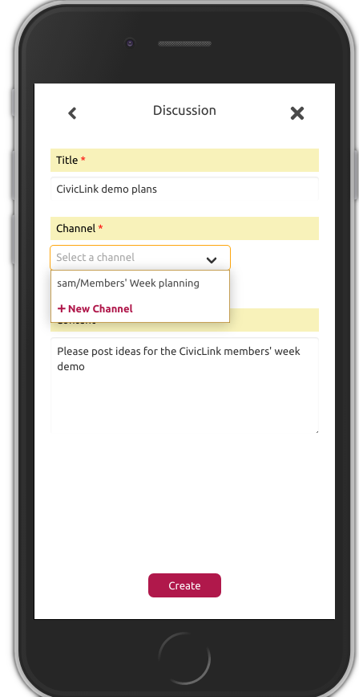
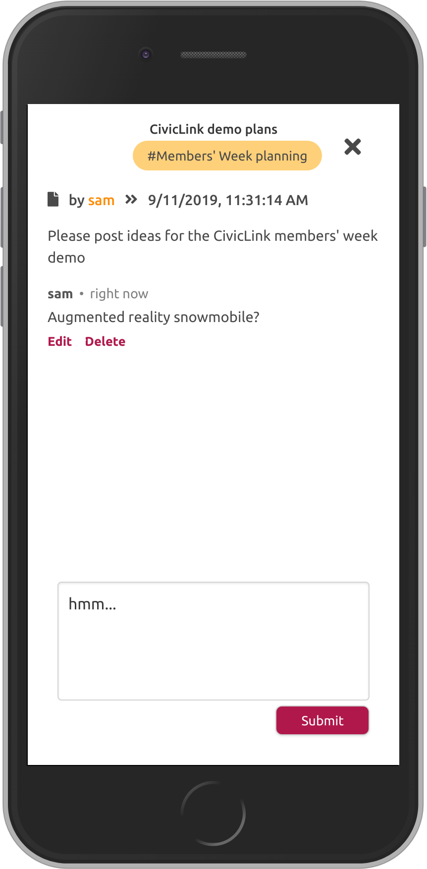
Post events & discussions publicly, or create members-only channels!
Viral Communications
September 2019
Viral Communications
September 2019
Andrew Lippman
Andrew Lippman

Slide 12
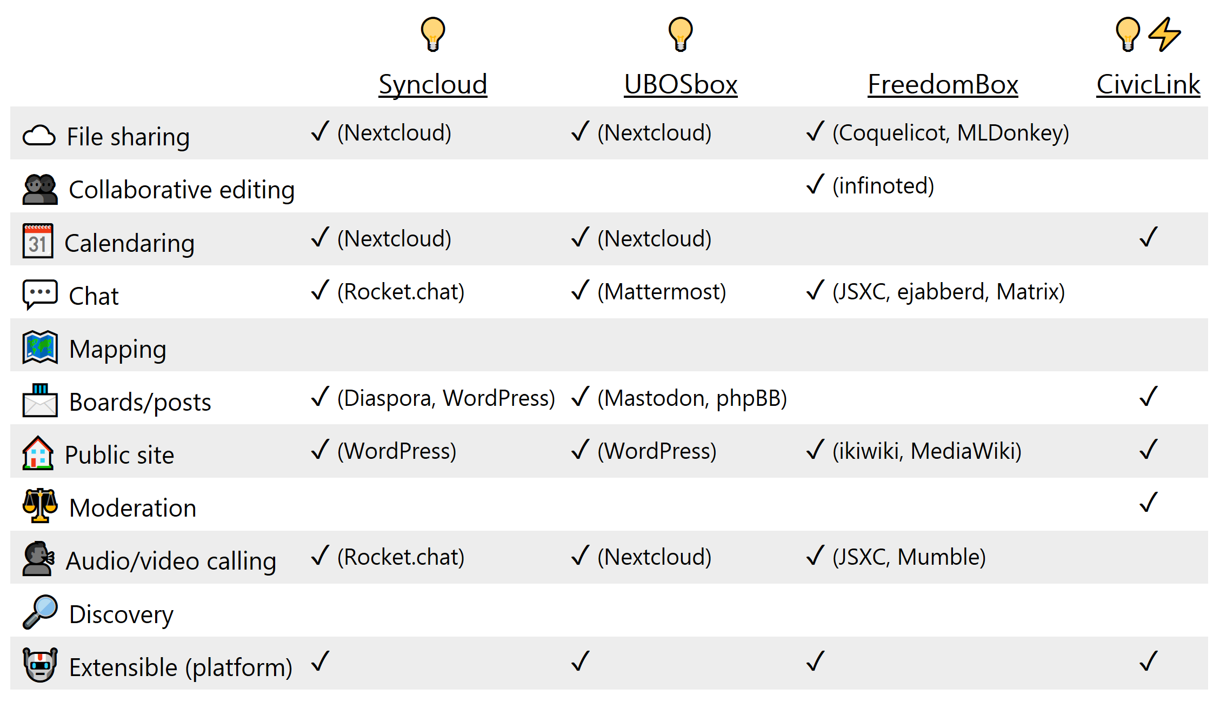
Limitations
No file sharing/editing
No real-time chat
No discovery
Work in progress!
Viral Communications
September 2019
Viral Communications
September 2019
Andrew Lippman
Andrew Lippman

Slide 13
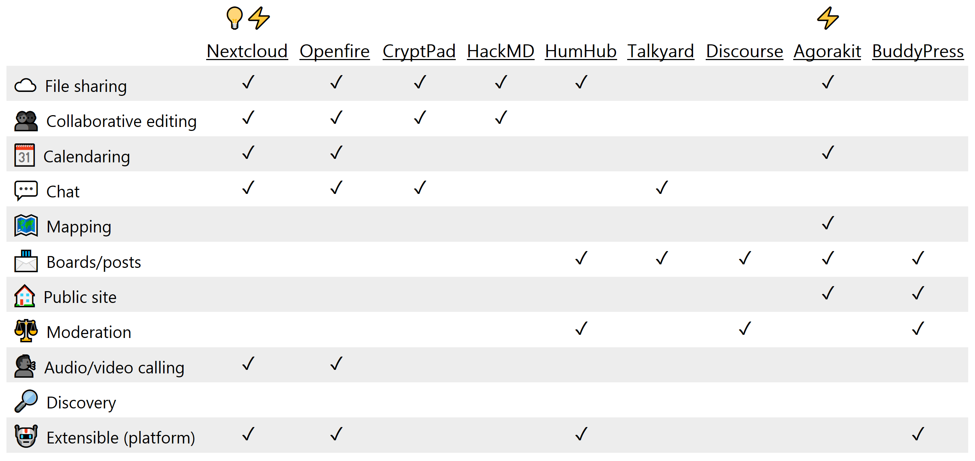
Servers (dedicated)
Viral Communications
September 2019
Viral Communications
September 2019
Andrew Lippman
Andrew Lippman

Slide 14
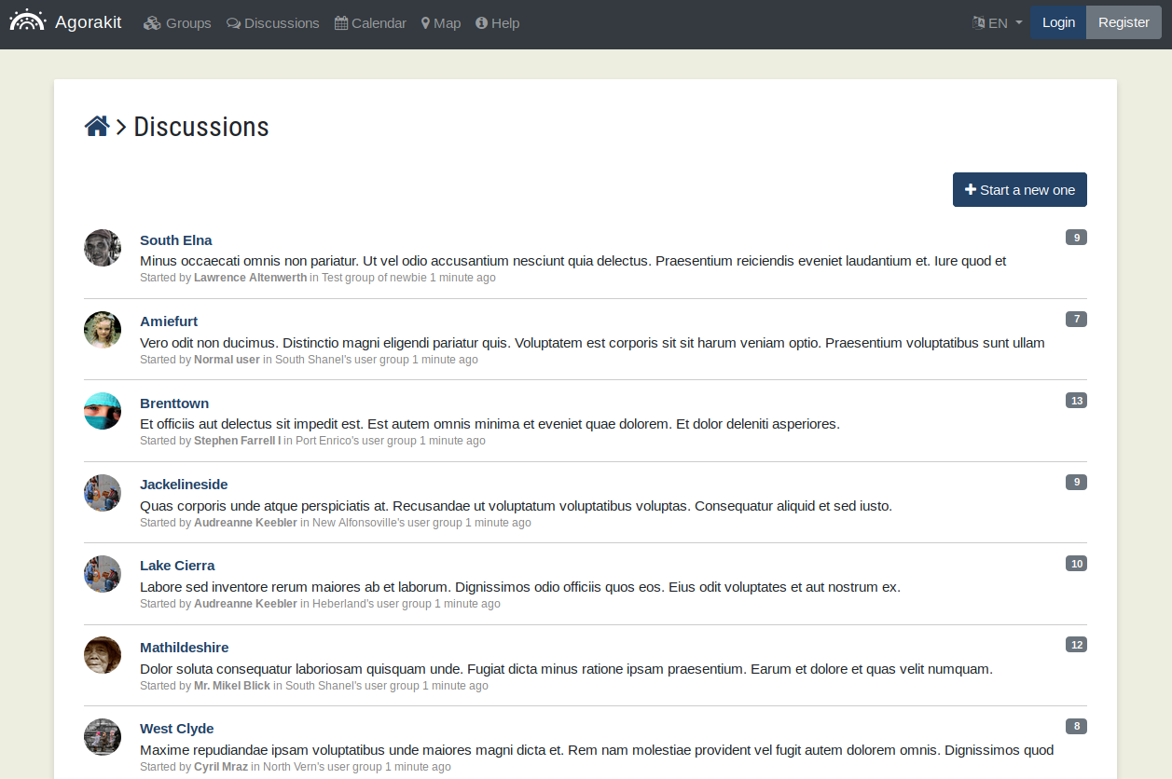
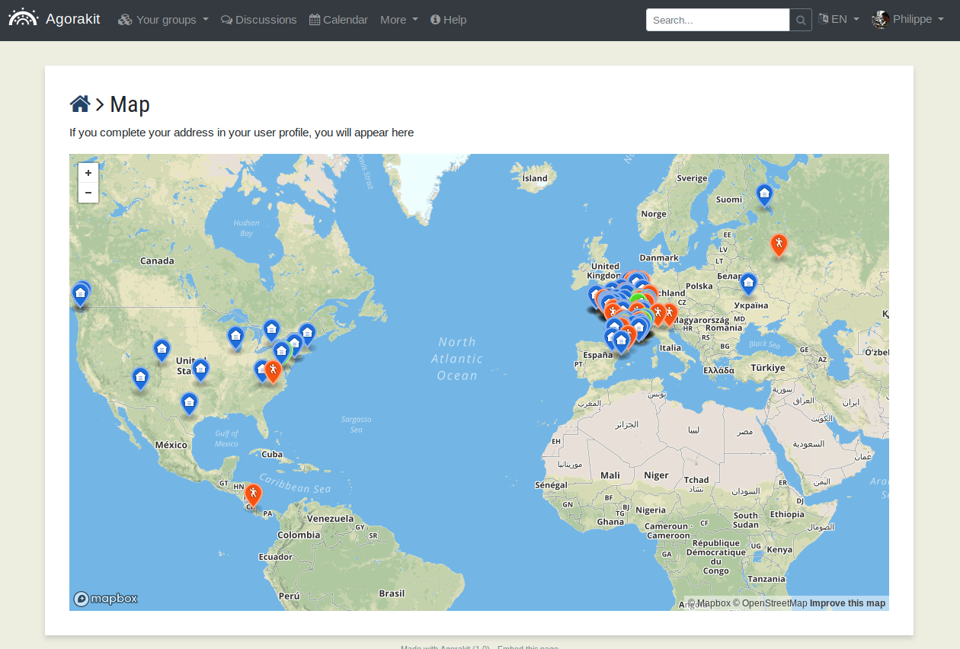
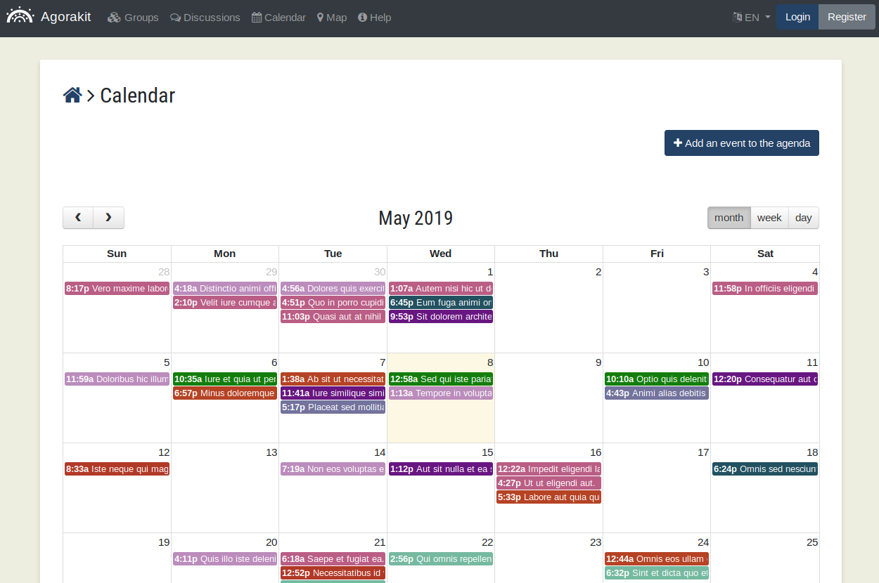
Agorakit
Viral Communications
September 2019
Viral Communications
September 2019
Andrew Lippman
Andrew Lippman

Slide 15
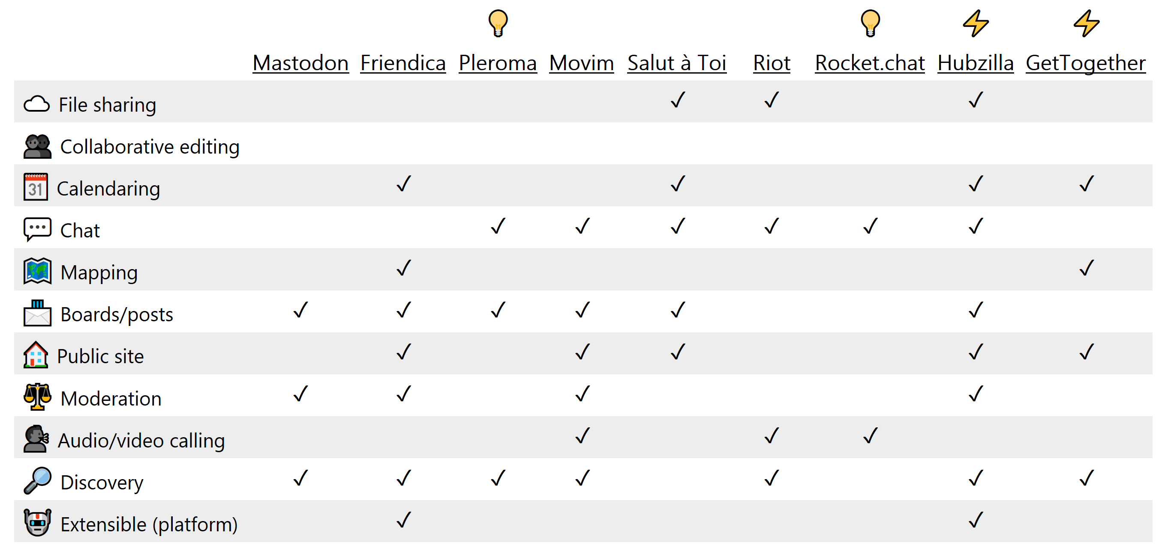
Servers (federated)
Viral Communications
September 2019
Viral Communications
September 2019
Andrew Lippman
Andrew Lippman

Slide 16
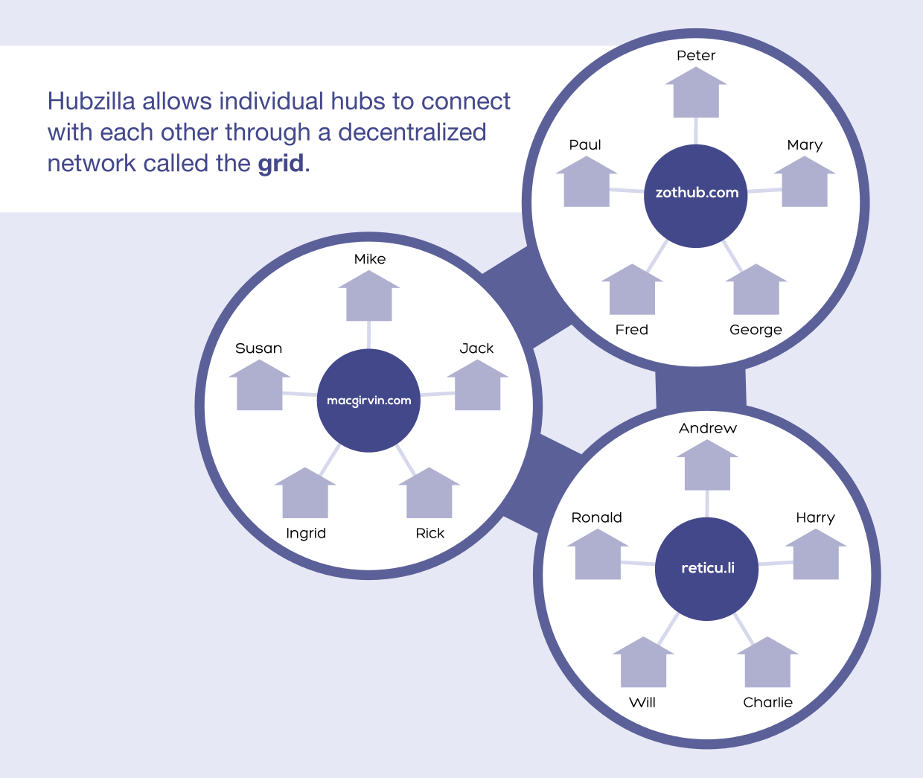
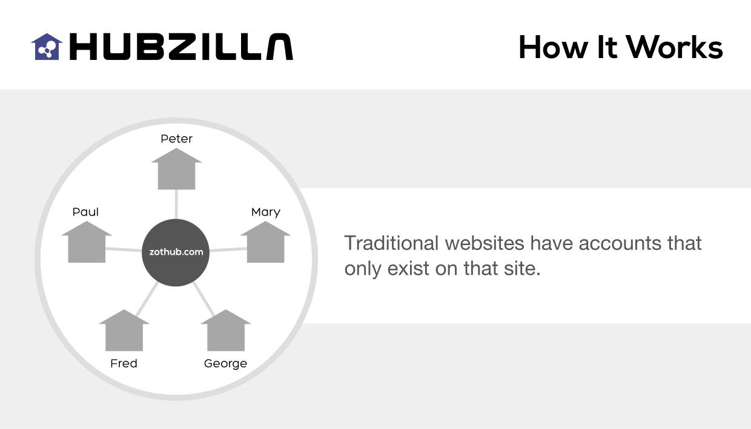
Hubzilla
Viral Communications
September 2019
Viral Communications
September 2019
Andrew Lippman
Andrew Lippman

Slide 17
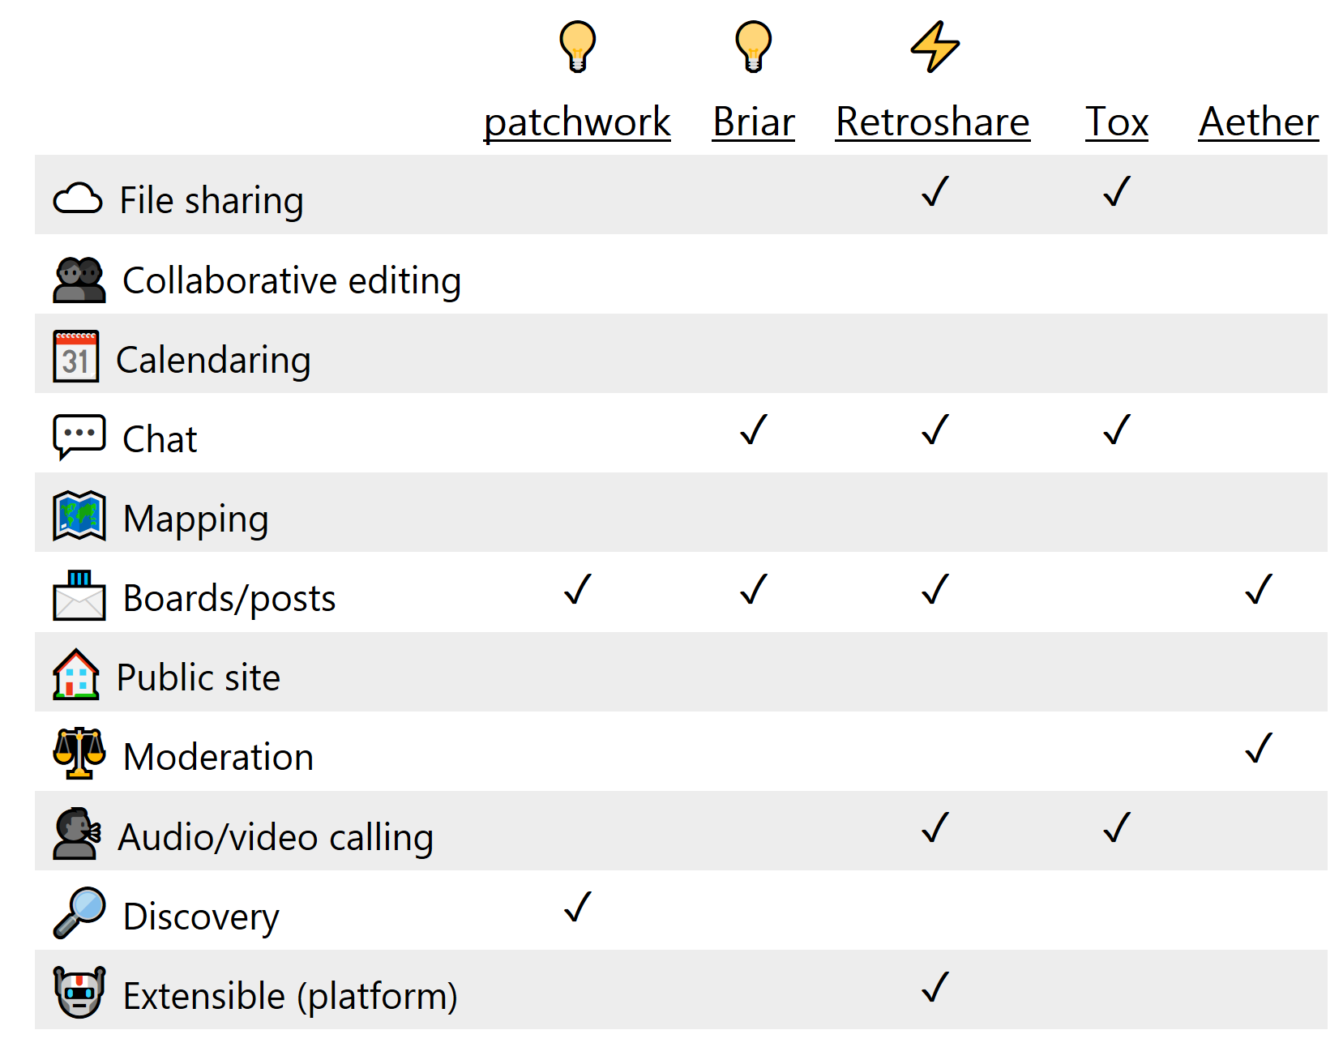
Serverless (P2P)
Viral Communications
September 2019
Viral Communications
September 2019
Andrew Lippman
Andrew Lippman

Slide 18
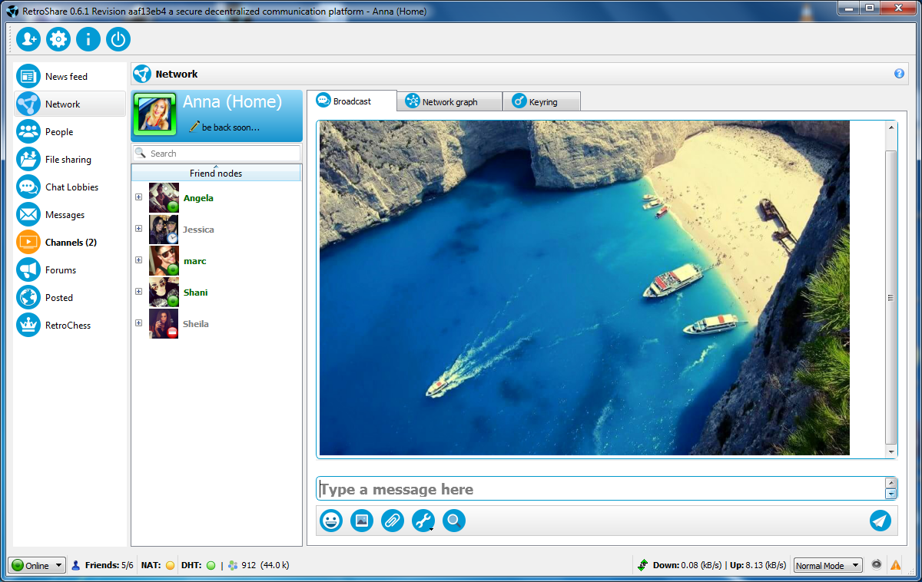
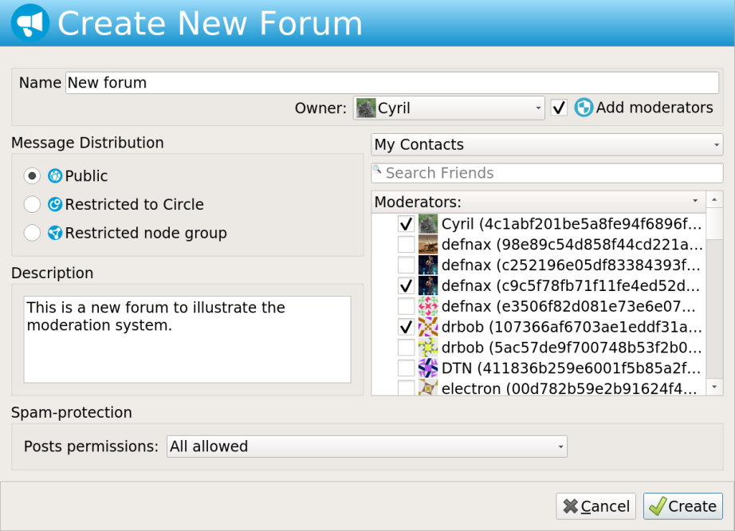
Retroshare
Viral Communications
September 2019
Viral Communications
September 2019
Andrew Lippman
Andrew Lippman

Slide 19
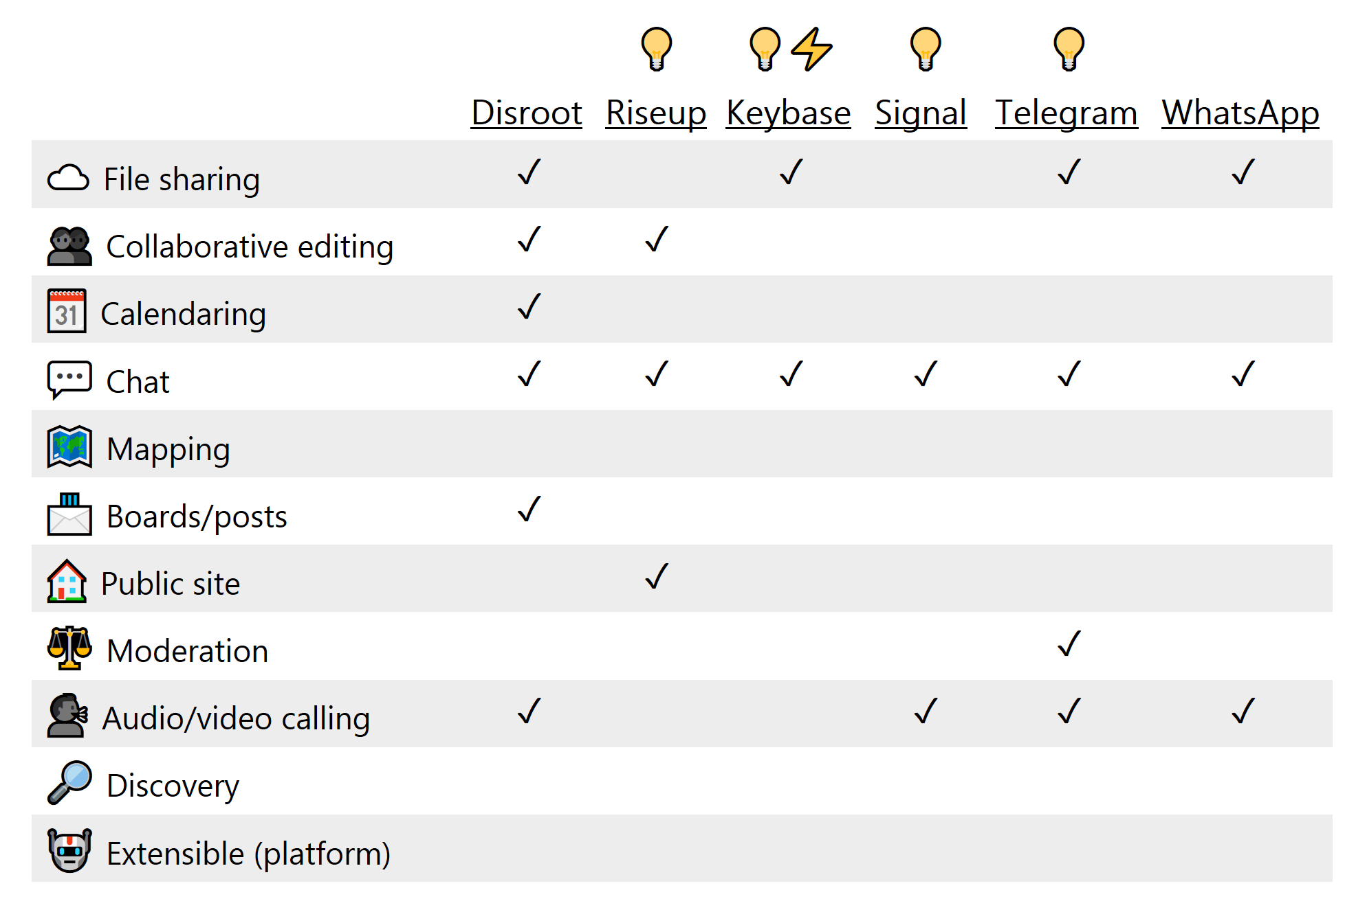
Services (free)
Viral Communications
September 2019
Viral Communications
September 2019
Andrew Lippman
Andrew Lippman

Slide 20
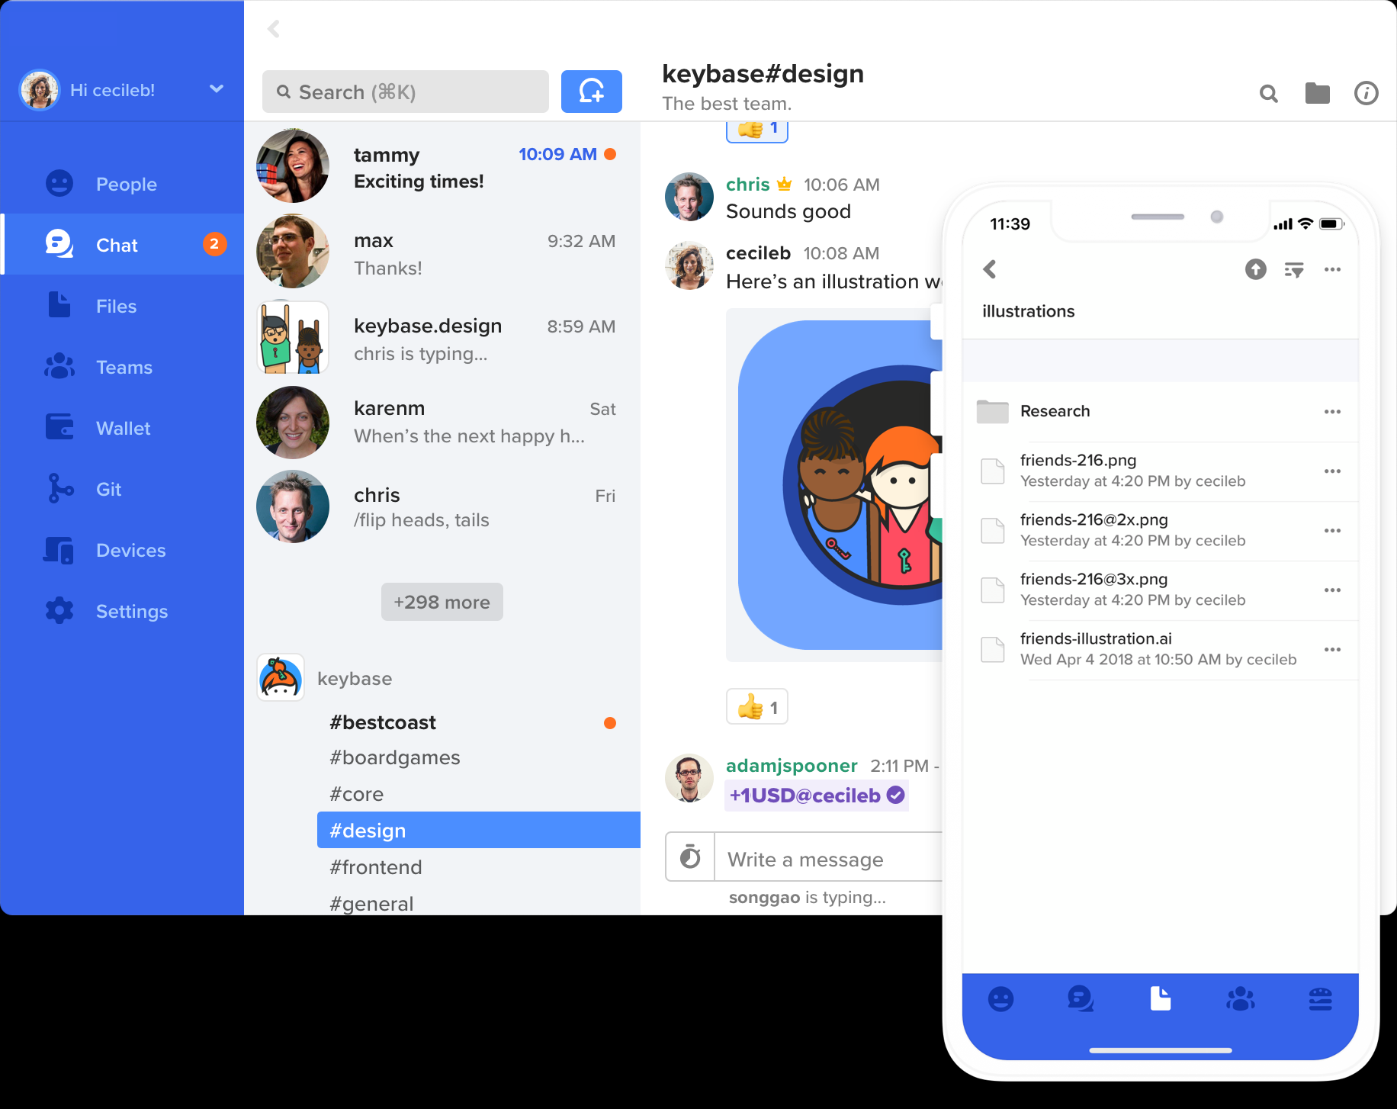
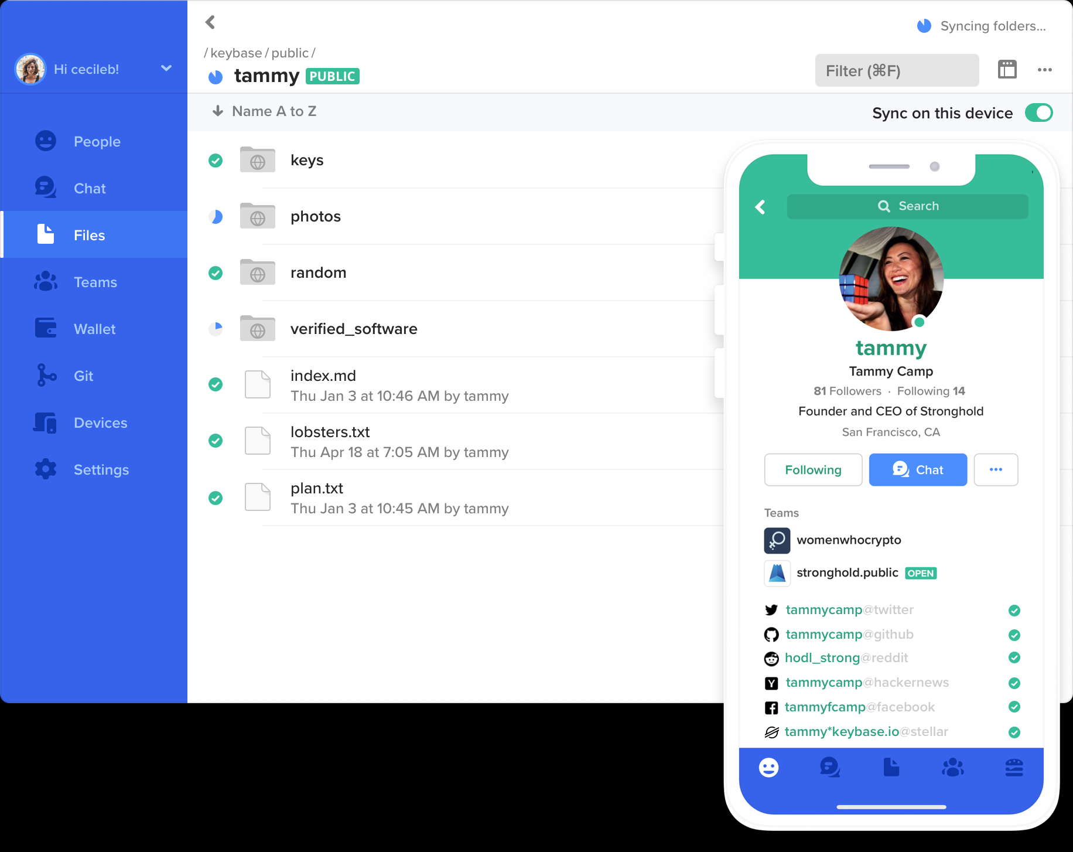
Keybase
Viral Communications
September 2019
Viral Communications
September 2019
Andrew Lippman
Andrew Lippman

Slide 21
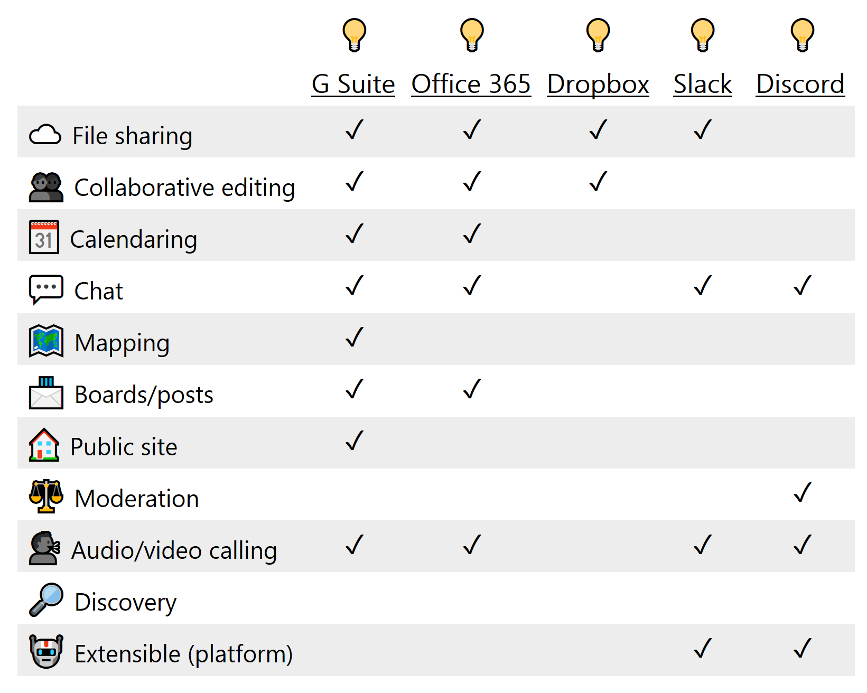
Services (freemium)
Viral Communications
September 2019
Viral Communications
September 2019
Andrew Lippman
Andrew Lippman

Slide 22
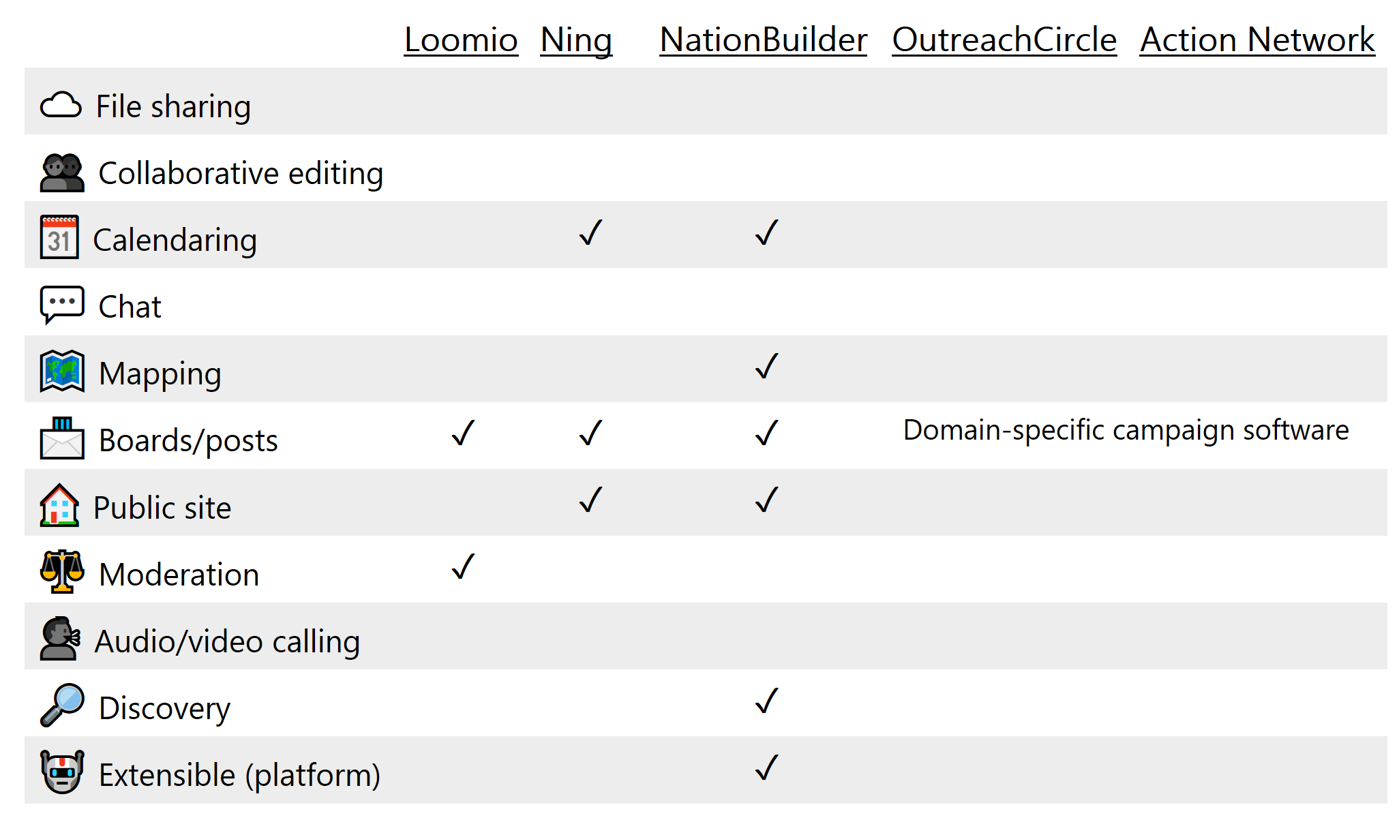
Services (premium)
Viral Communications
September 2019
Viral Communications
September 2019
Andrew Lippman
Andrew Lippman

